Slide 1
Reading Cloud mobile app
School logo

Slide 2
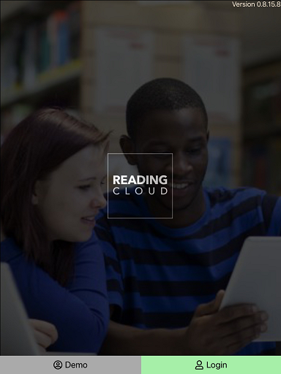
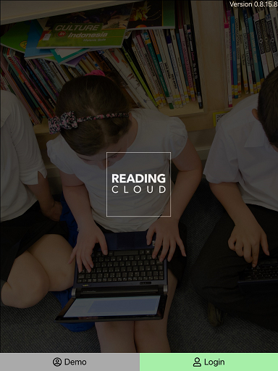
Using your library just got easier!
You can now access school library resources anytime with the Reading Cloud mobile app
The Reading Cloud app is a convenient way for you to benefit from access to all the resources in the school library, 7 days a week, from inside and outside school, on Apple, iOS or Android devices.
You don’t have to download the app – you can access Reading Cloud on any desktop!

Slide 3
How does it work?
With the Reading Cloud app you can:
Check your library account
Use your virtual library ticket when having books issued in the library
Search library resources and make reservations
View the newest arrivals and most popular books
View recommended reads with Who Next
Write and share reviews
Check in on the latest news from the library
Read ebooks and listen to audiobooks - There are hundreds of titles for you to choose from!

Slide 4
Getting started

Slide 5
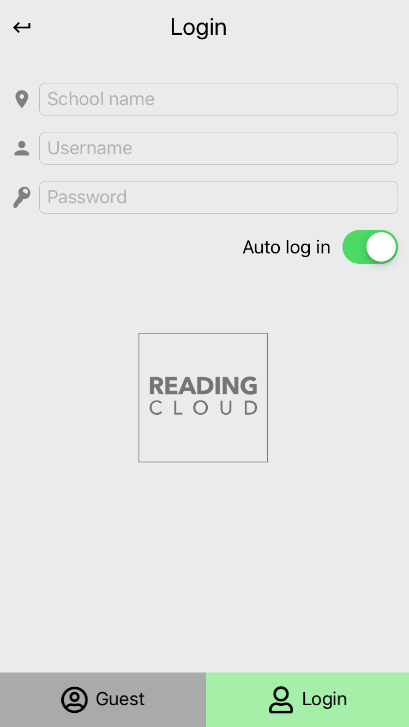
Logging in
Download the app to your device from the app store
Enter your log in details: School name Username Password
Click Login – this is the same username and password for logging into the system at the academy

Slide 6
Your homepage options
Once you have logged into your library account you will find a menu listing all you can do with the app and it’s easy to find your way around.
My Library Barcode is your virtual library ticket showing your borrower number details. It can be scanned when having books issued to you in the library when you return to the academy.

Slide 7
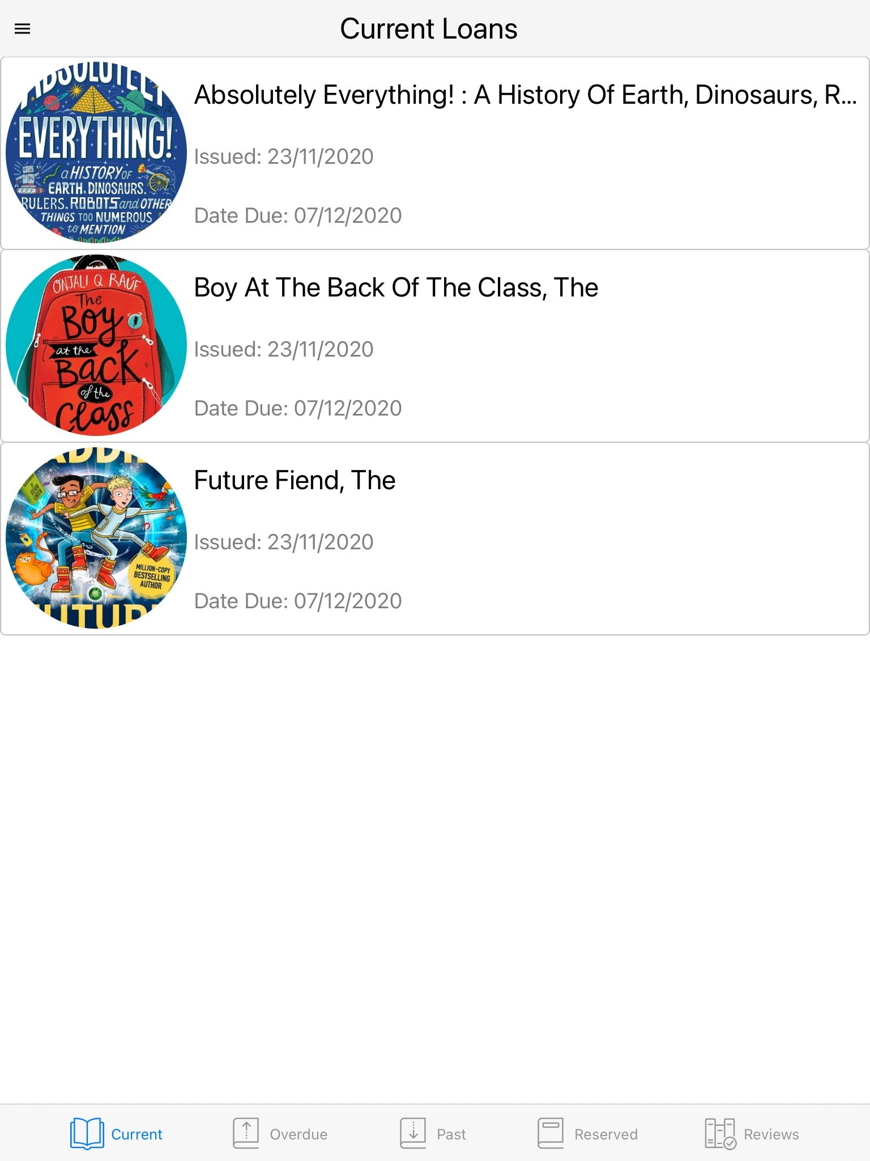
Your Library Account
Within My Account you can keep on top of all your borrowing activities.
You can view items you have on loan, any overdue loans and see all your past loans, reviews and current reservations.
Just select the appropriate tab at the bottom of the screen to view.

Slide 8
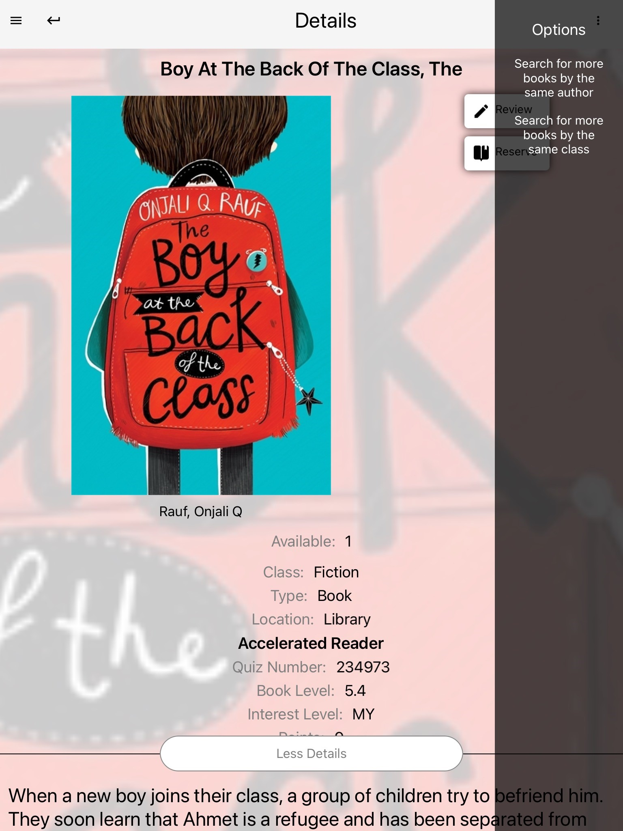
Searching the Library Catalogue
You can search for resources in a number of ways including; by title, author, subject and ISBN.

Slide 9
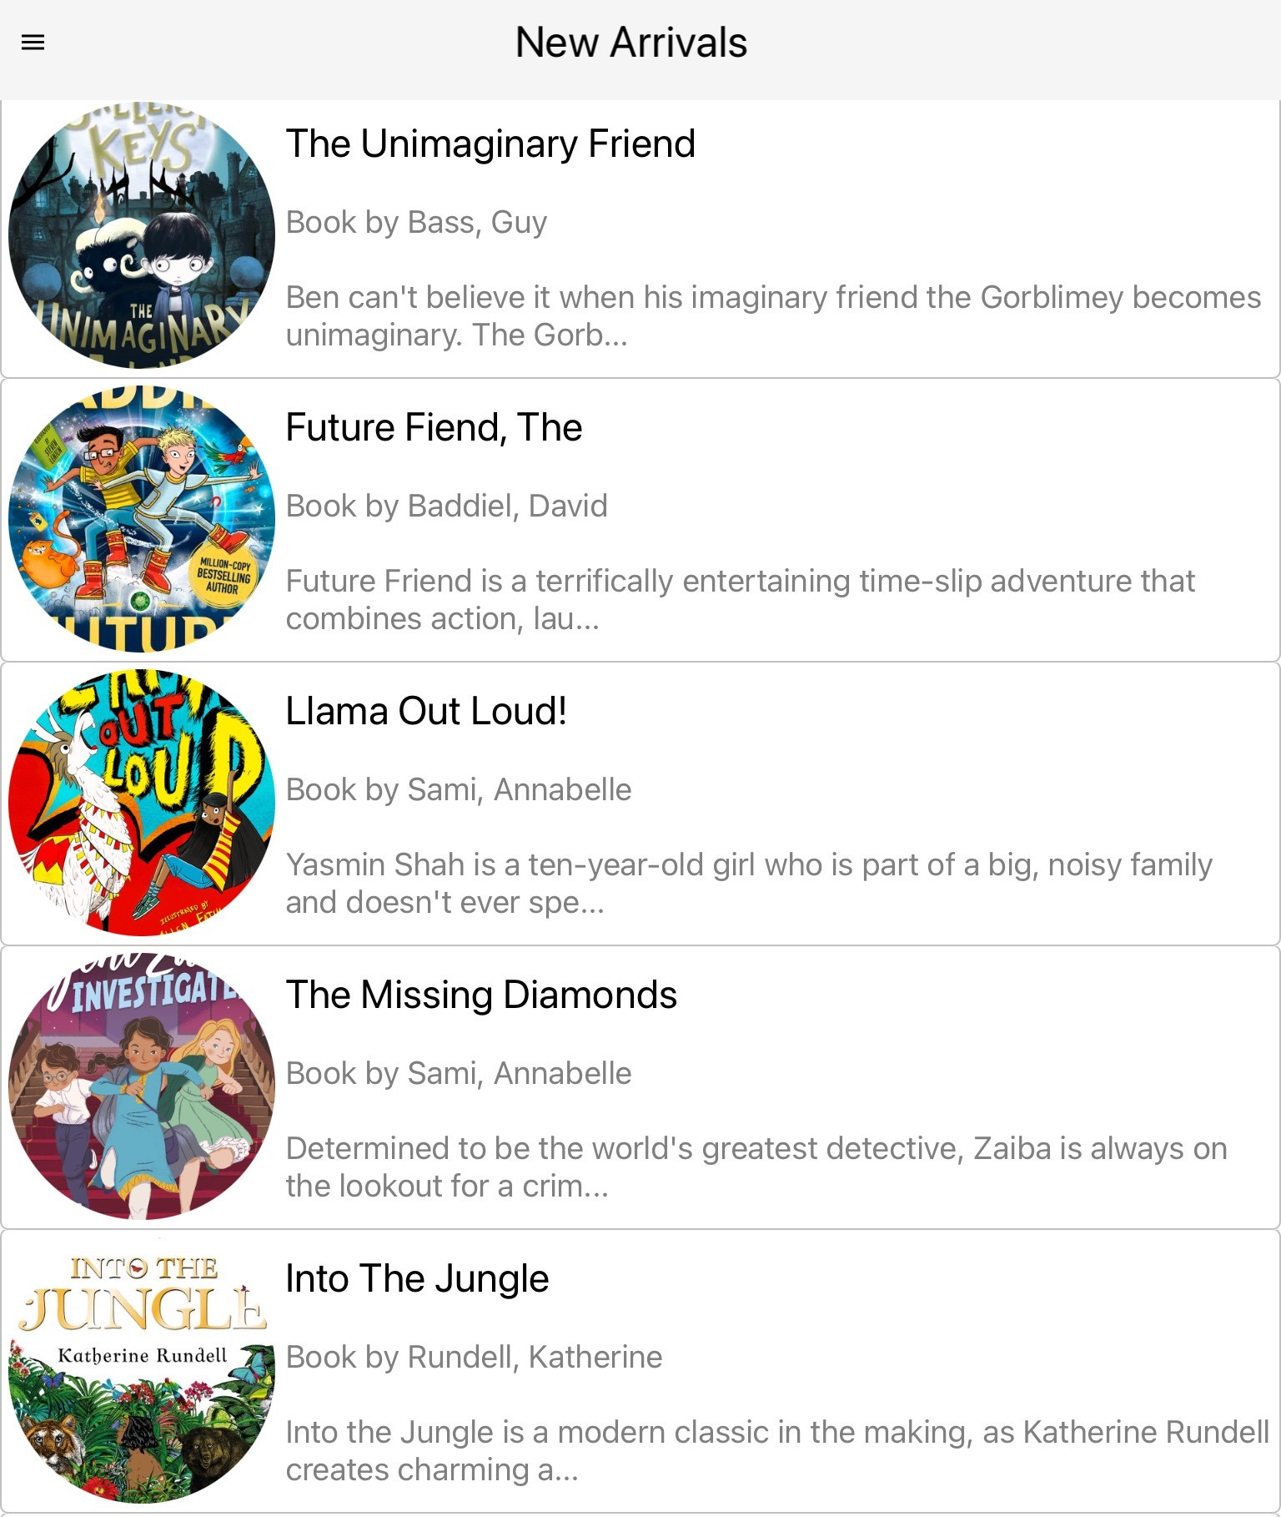
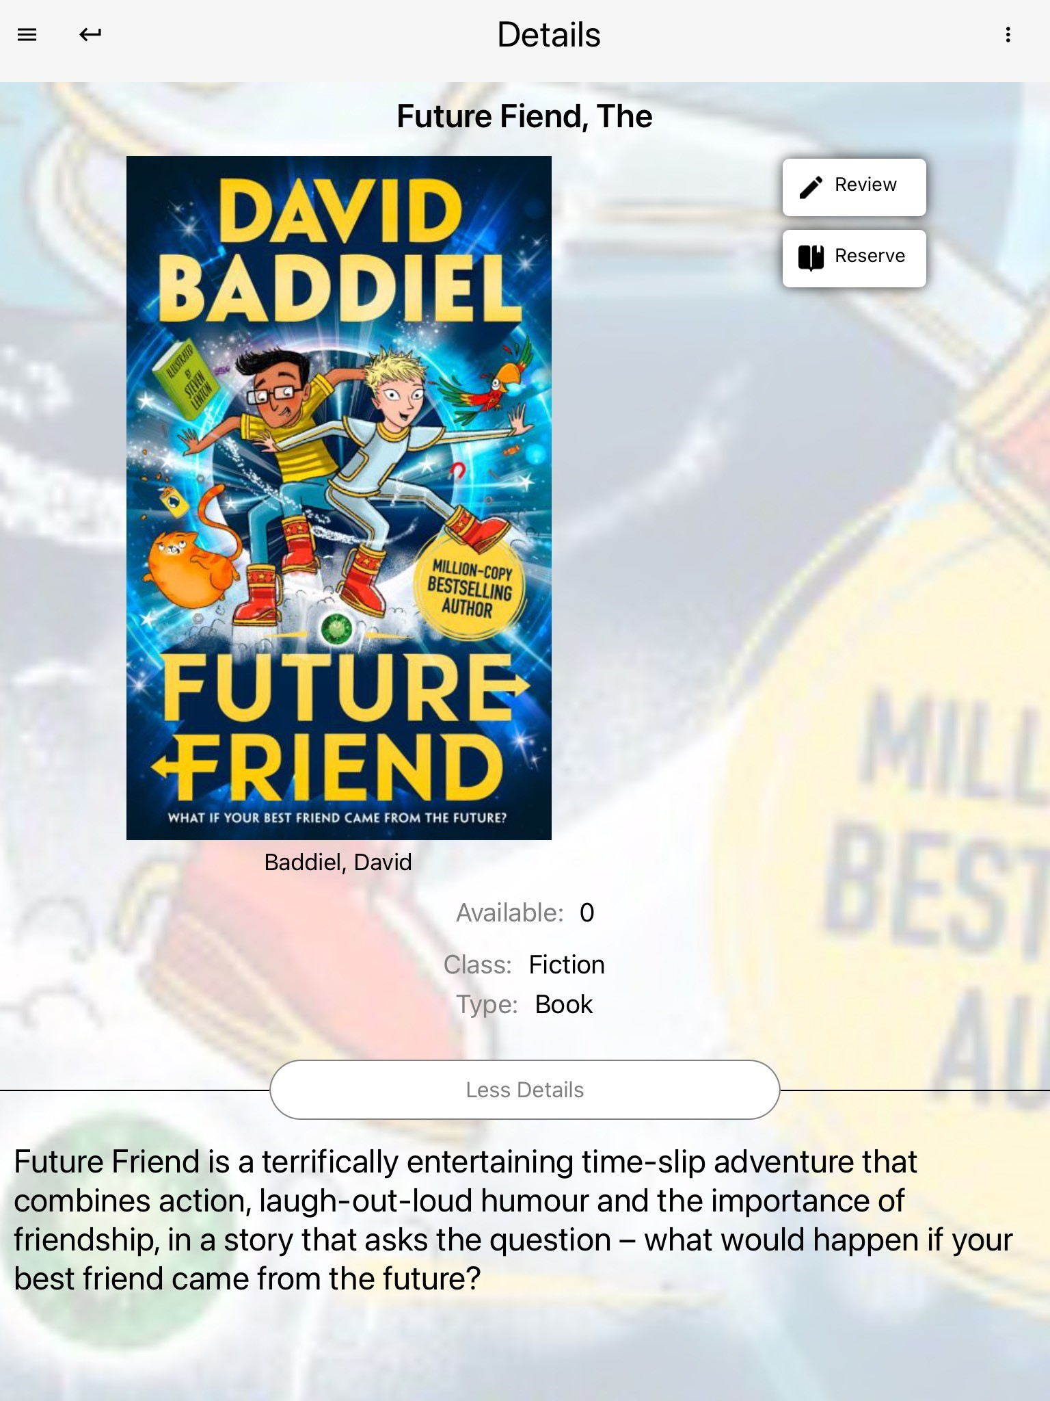
New Arrivals and Book of the Week
New Arrivals gives details of all the wonderful new books available in your library.
Book of the Week features a book chosen and recommended by your school librarian.

Slide 10
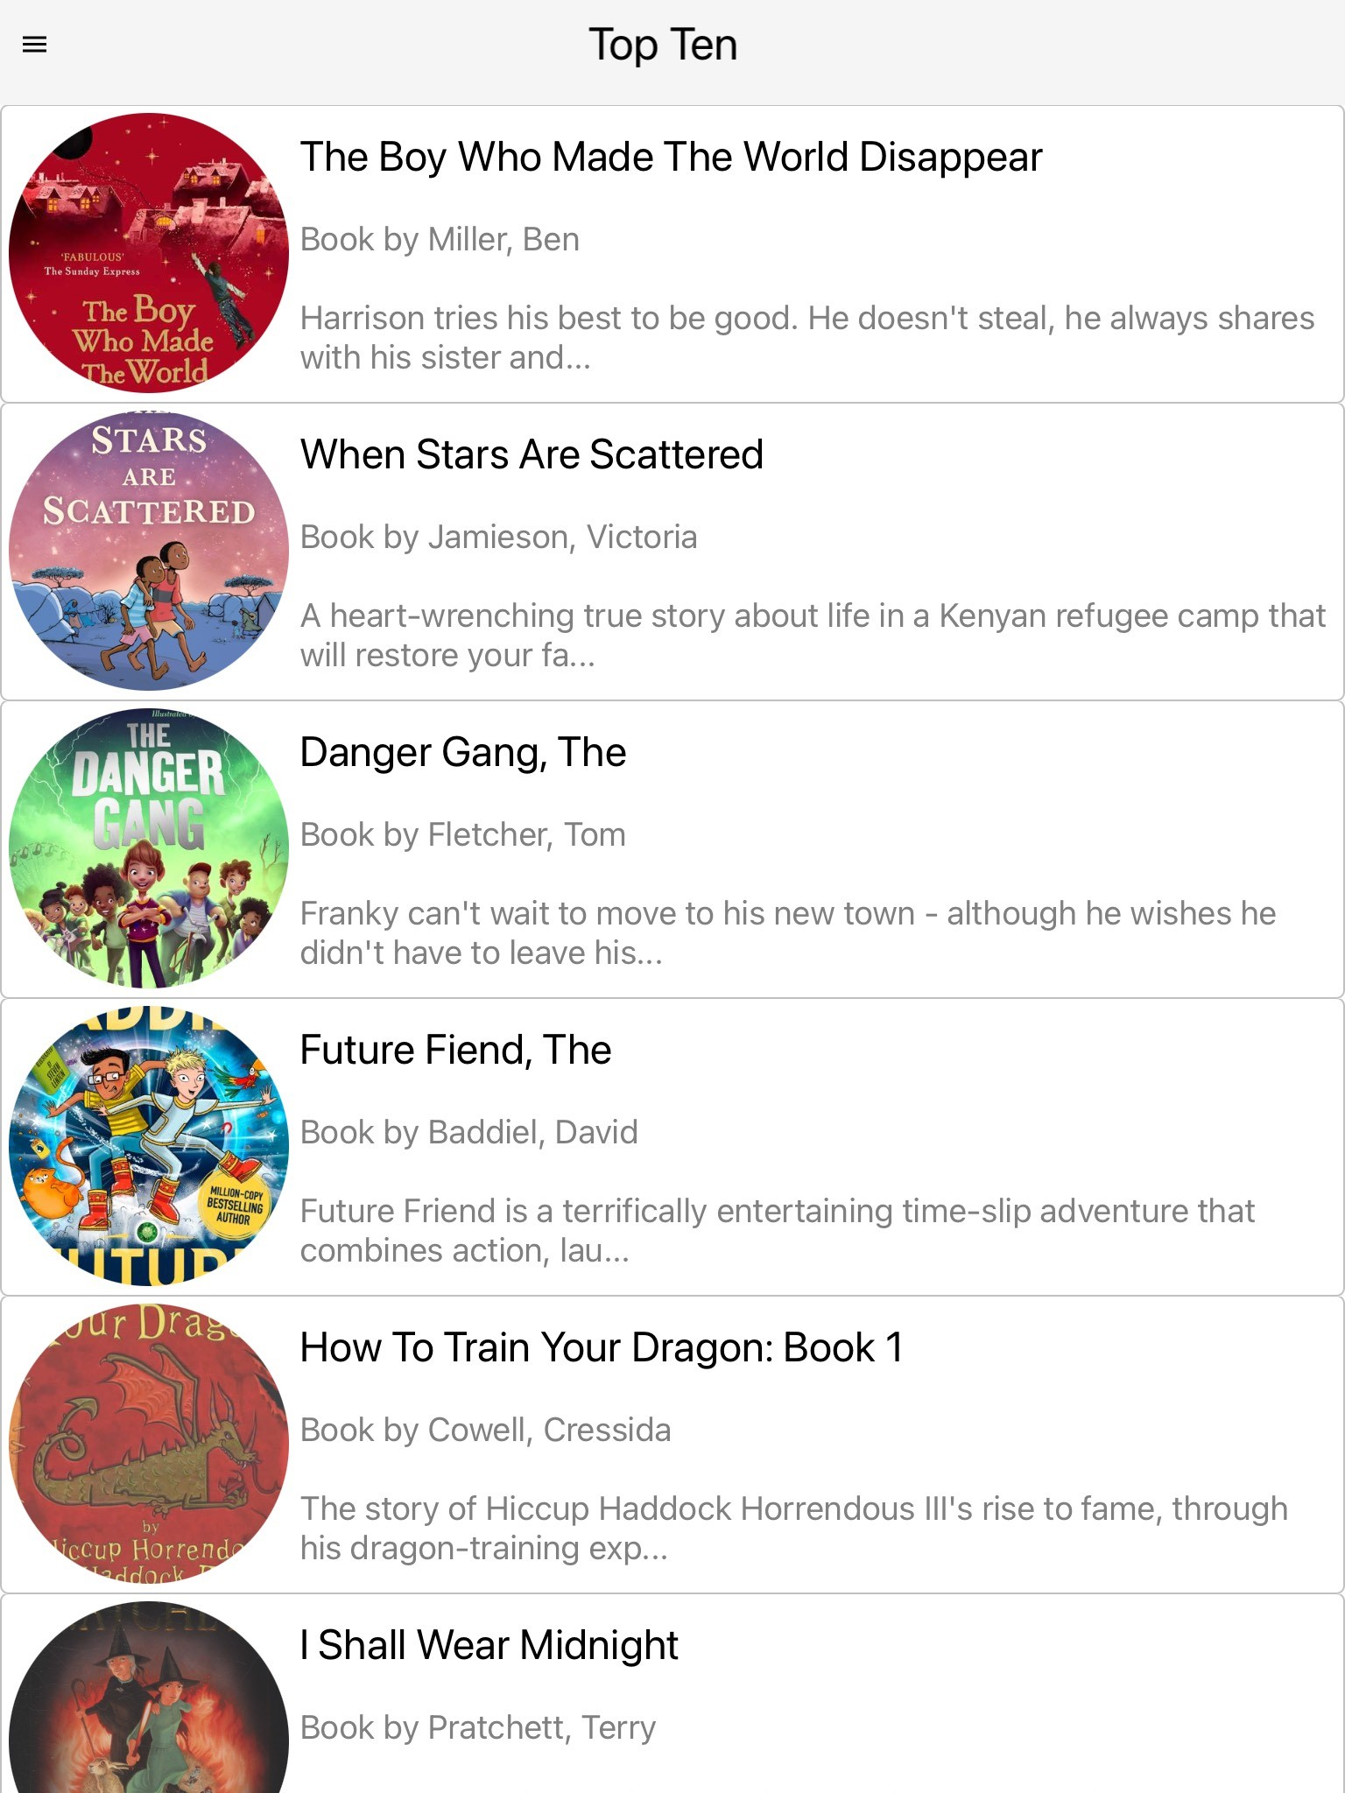
Top Ten
Top Ten lists the current most borrowed resources in your library.
It’s always worth checking to see what is trending and what you may then like to reserve and borrow yourself.

Slide 11
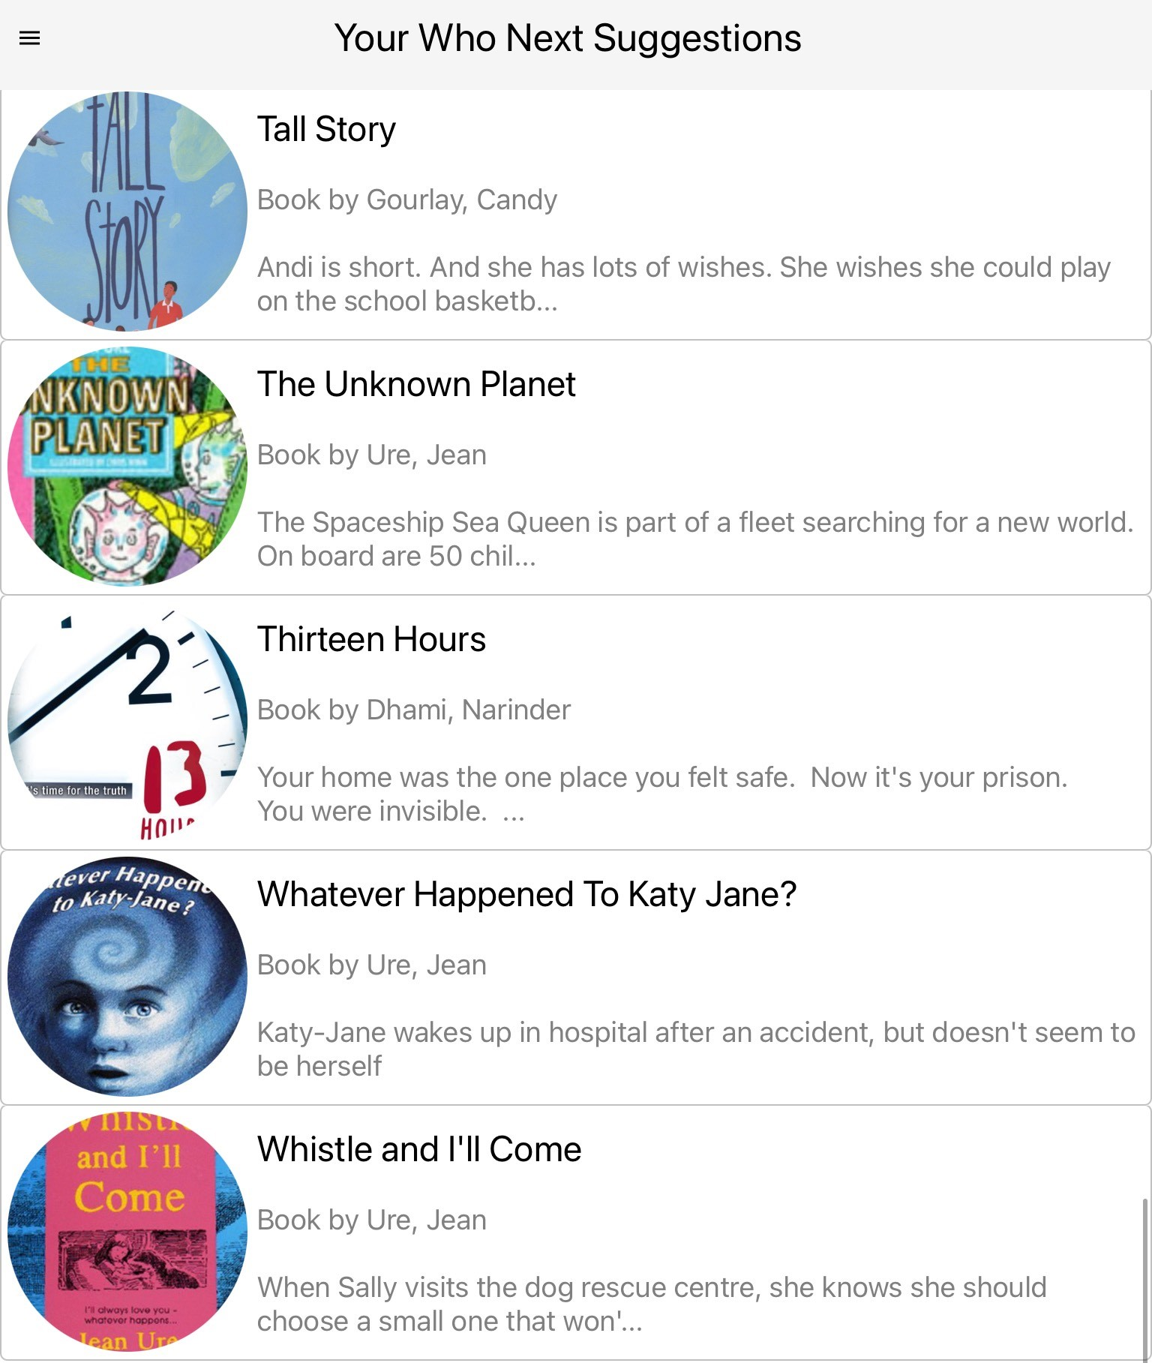
Who Next?
Who Next shows suggested books available in your library based on books and authors you have previously enjoyed reading.

Slide 12
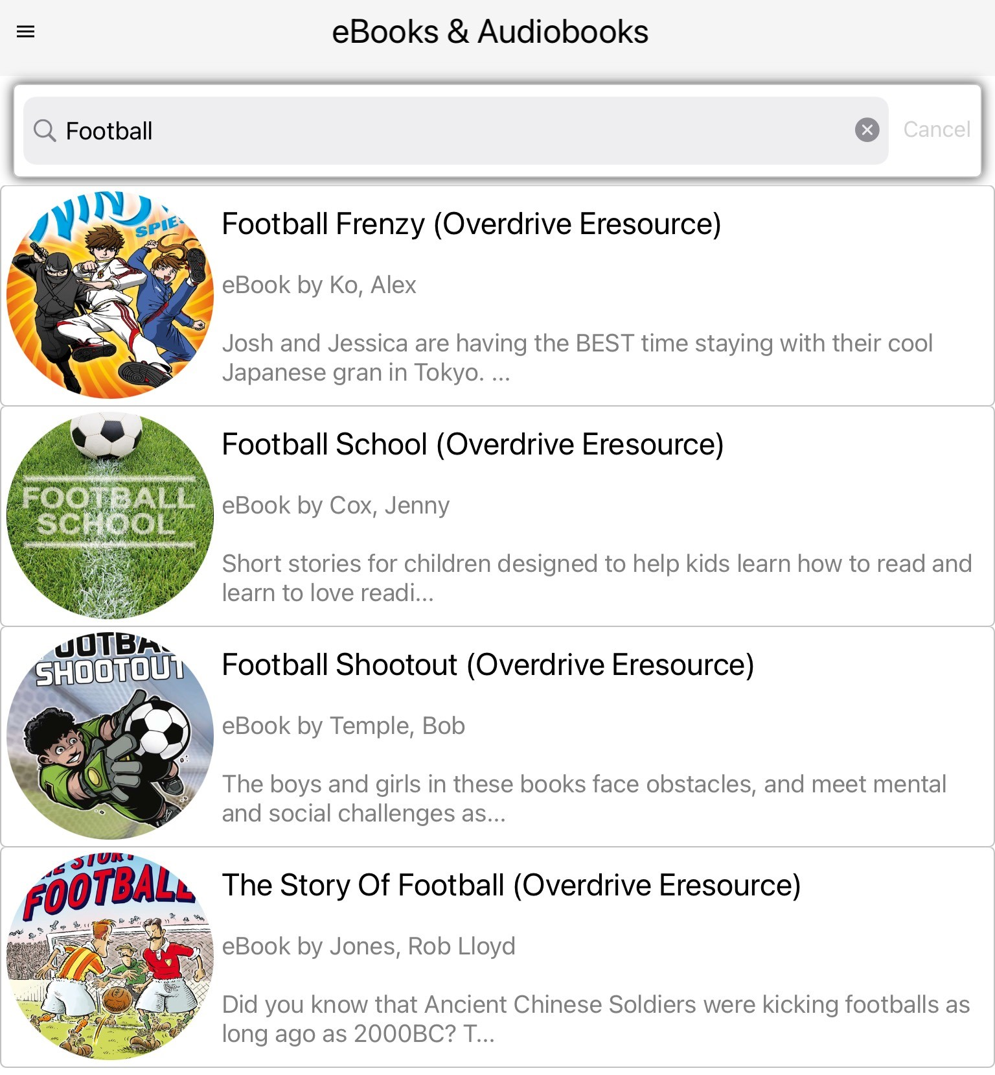
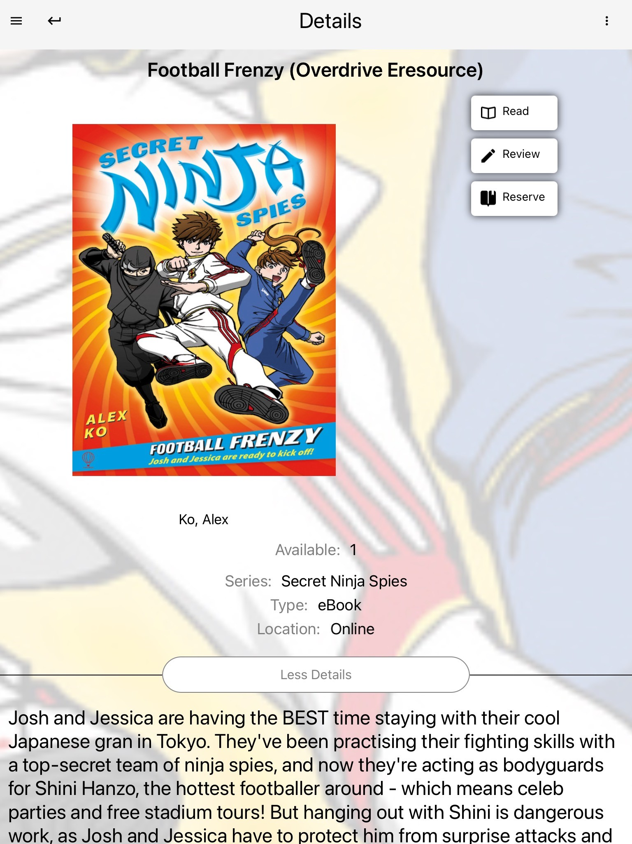
Ebooks and audio books
If your school has ebooks and audiobooks in the catalogue you can use the search box to browse and borrow them.
Then read and listen to your ebook or audiobook on any device, whenever and wherever you like!

Slide 13
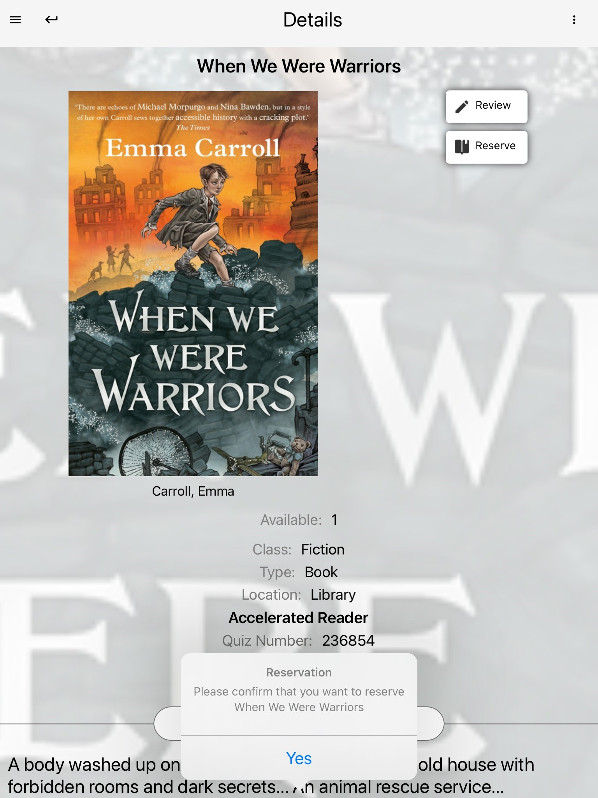
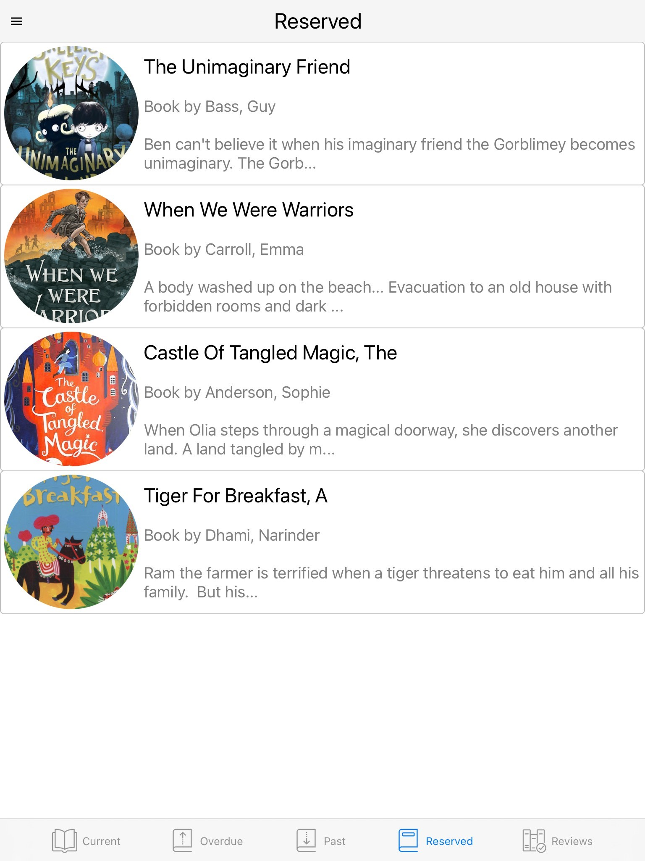
Reserving a resource
You can reserve books and resources from the library by selecting Reserve on the right of the screen when you see a book you might like to borrow & then choosing Yes to confirm.
You can see all your reservations within My Account.

Slide 14
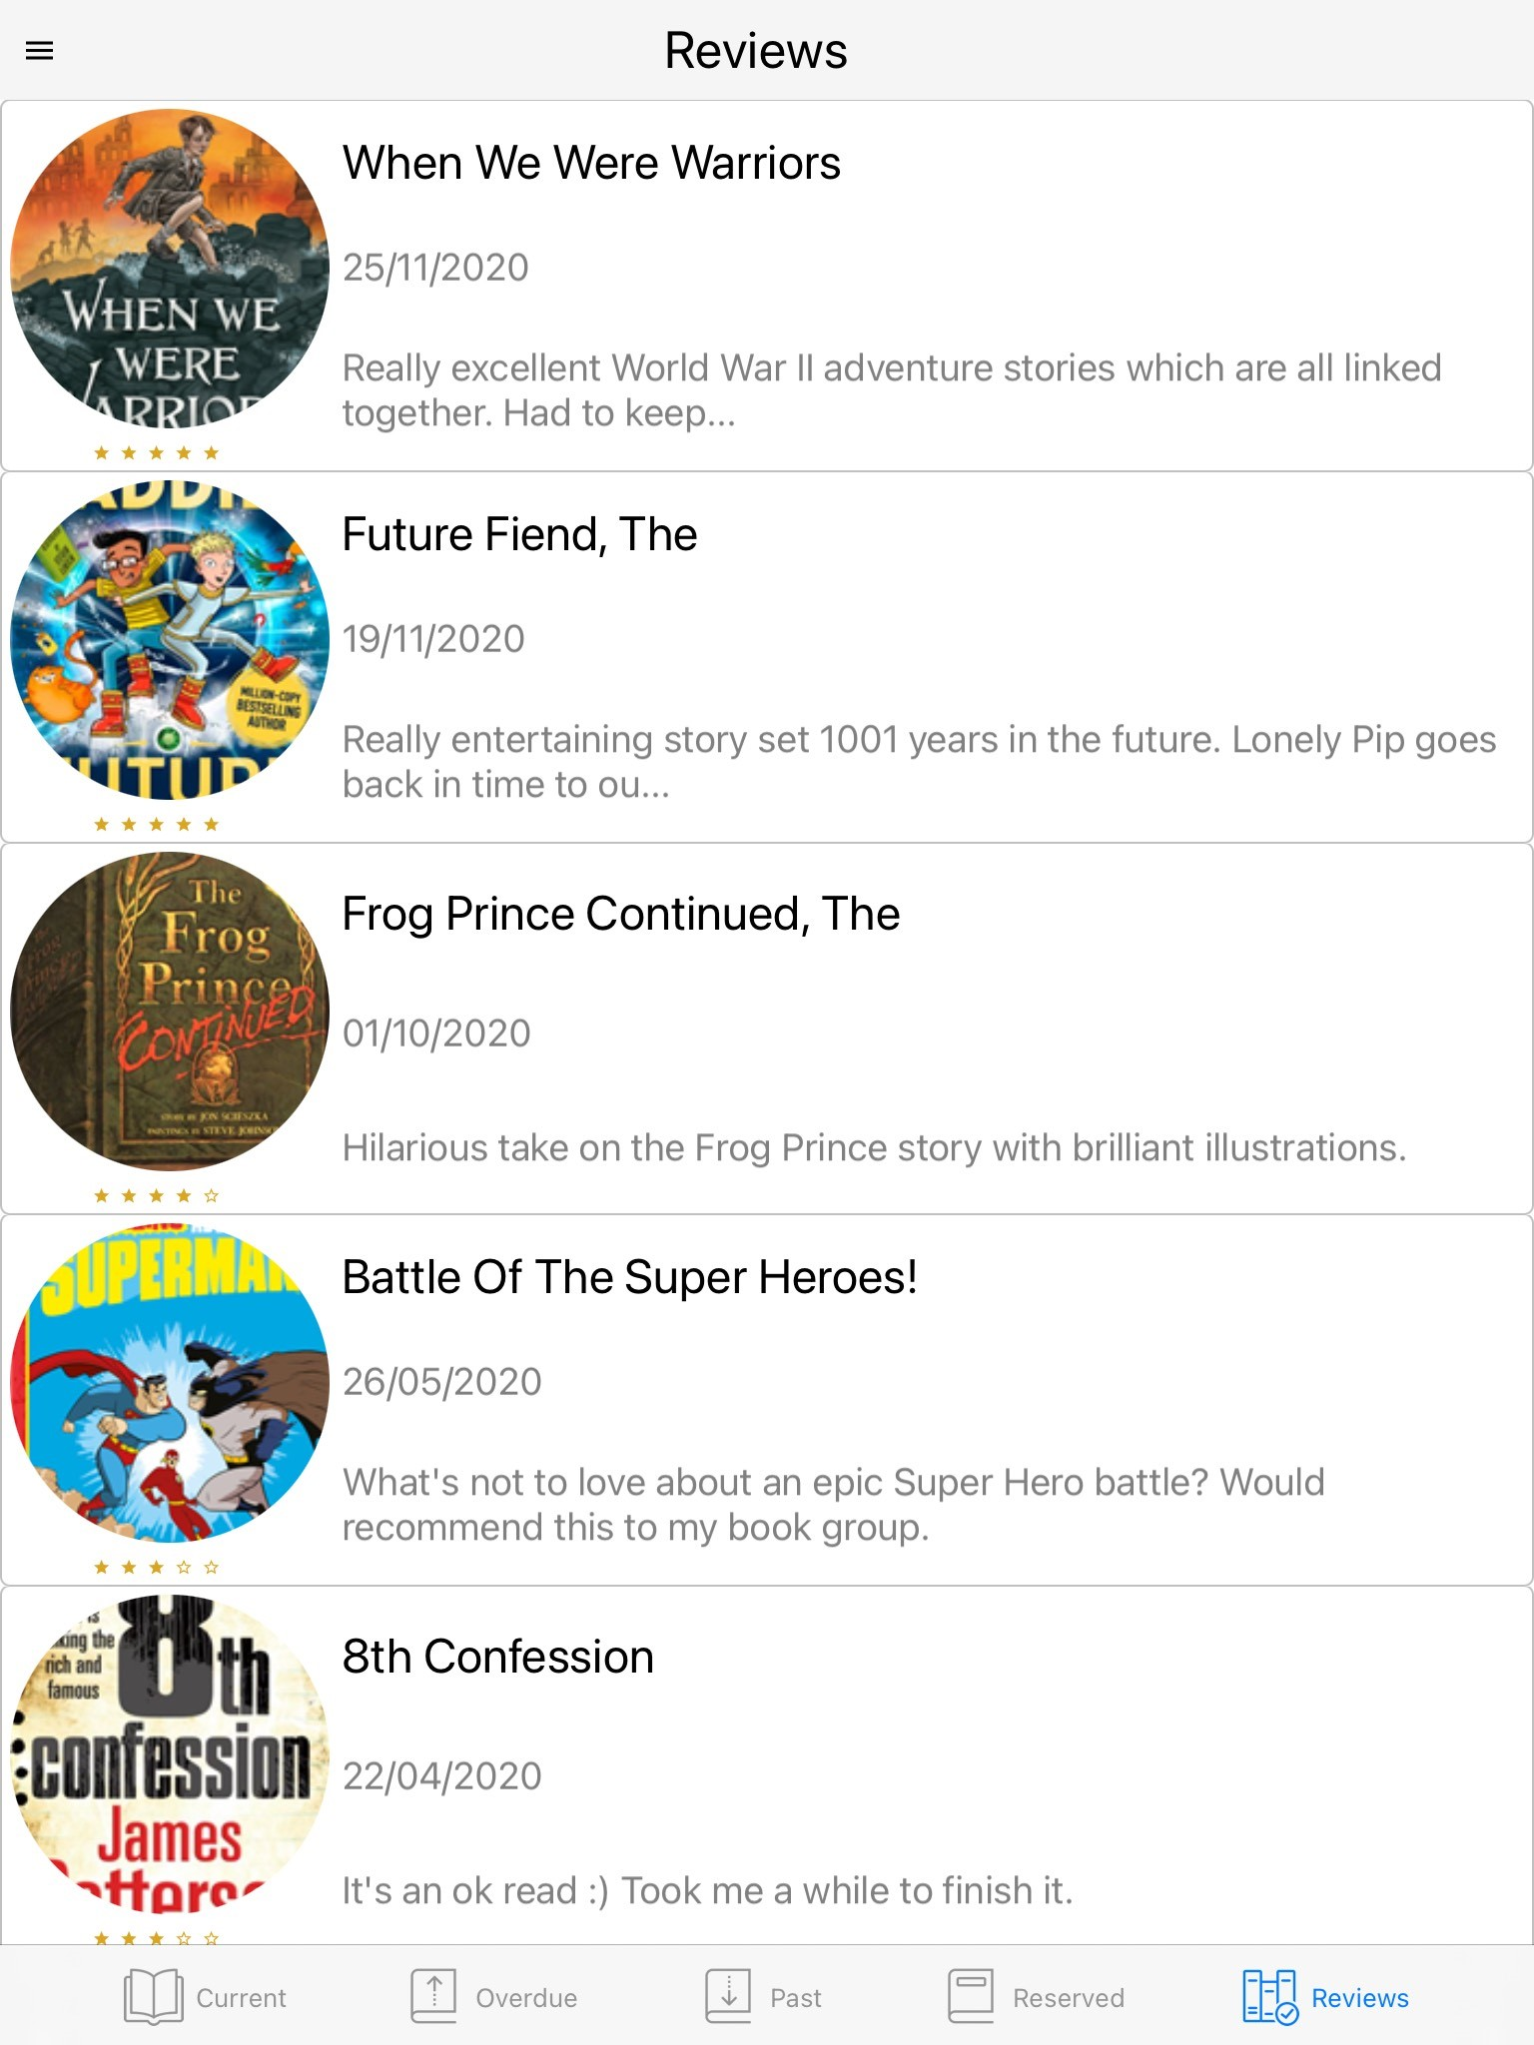
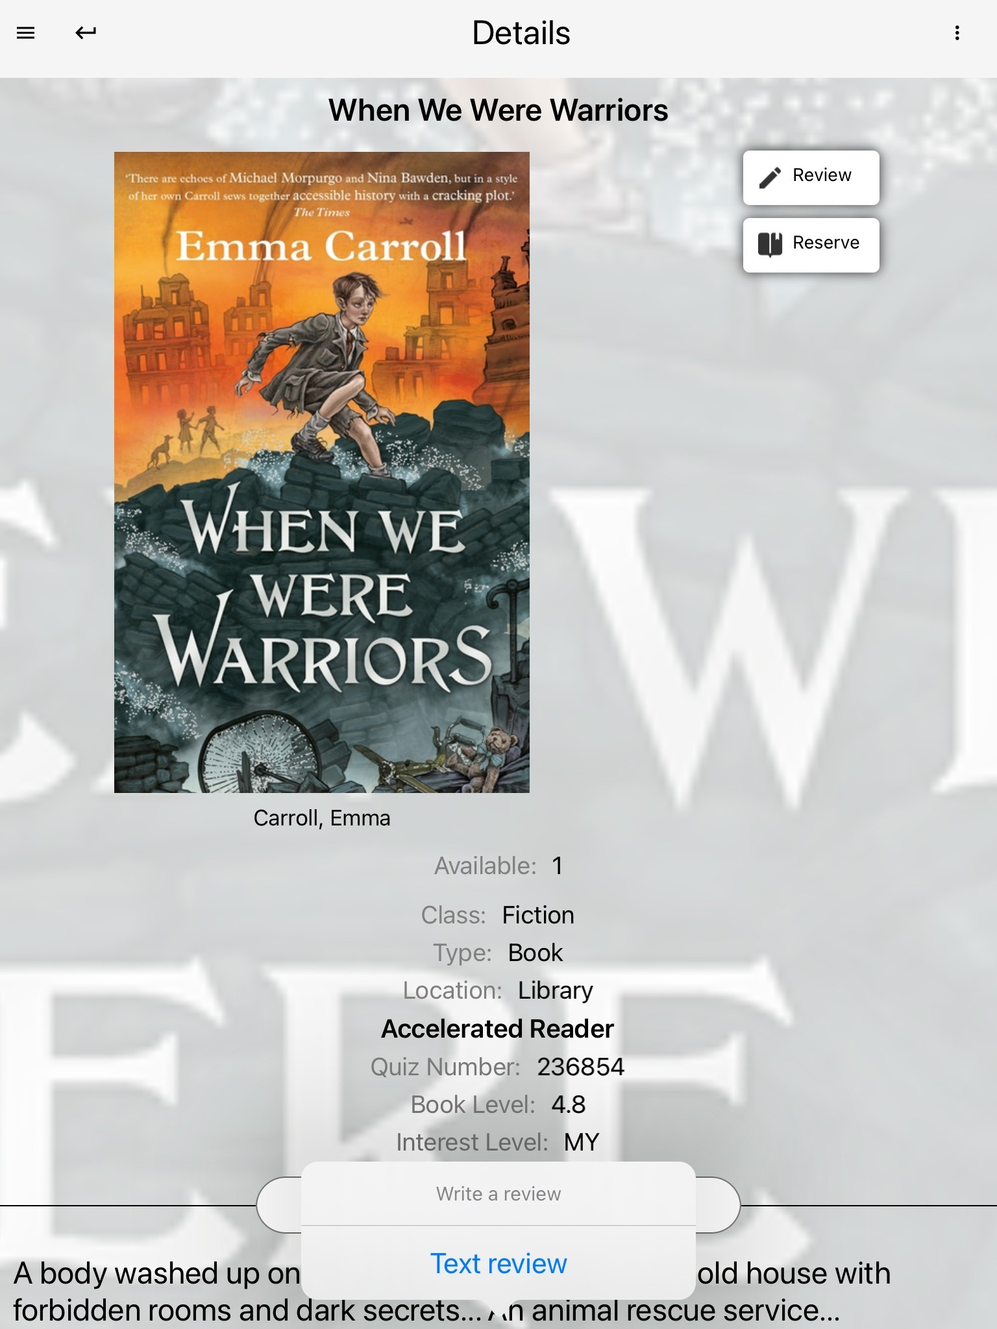
Sending in a Review
Select Review on the right of the screen for a book you want to review & then choose Text Review. The review box opens for you to type into. Select the tick on the right to save. Your review will then appear within My Account and when approved by your librarian in Latest Reviews.

Slide 15
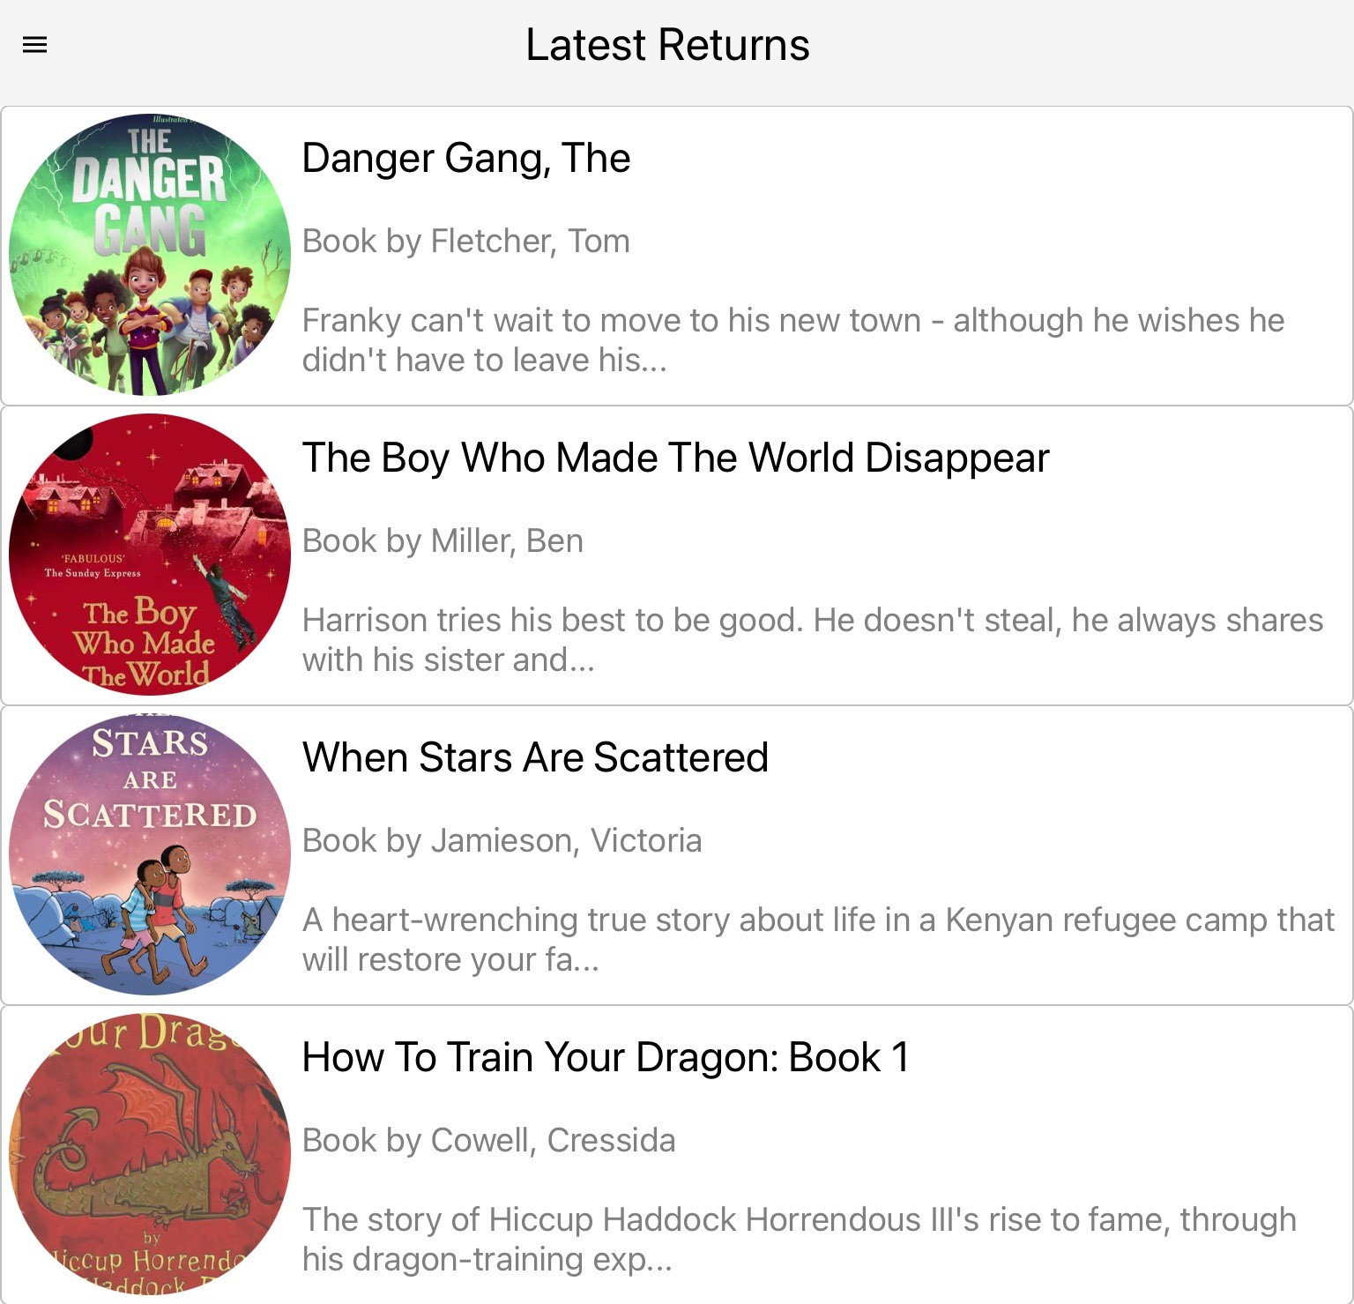
Latest Returns & Latest Reviews
Latest Returns keep you up-to date with popular books that have been borrowed by other students.
Latest Reviews showcases published reviews written by your student community.

Slide 16
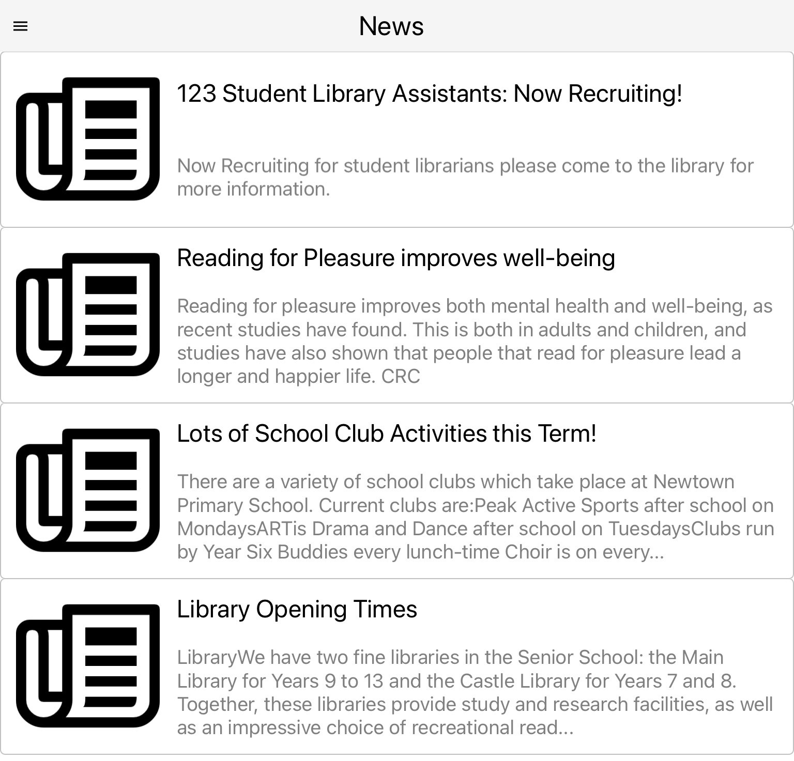
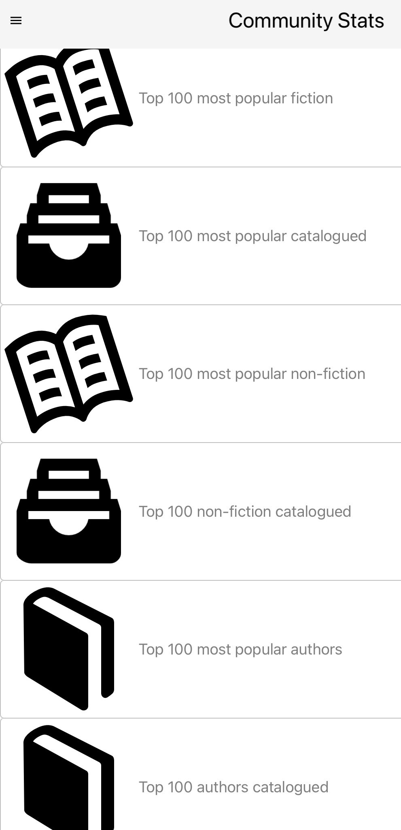
Library News & Community Stats
Keep up to date with what’s happening in your library by scrolling through the News area.
View statistics about books and authors from schools in the Reading Cloud Community with Community Stats.

Slide 17
If you have any problems downloading the app or logging into the Reading Cloud, please let your form tutor know and we will provide support.

